Slide 1




Deep Learning and HPC

Slide 2
Deep Learning
A subset of ML
Uses artificial neural networks with multiple layers
“Deep” means many hidden layers, enabling learning of complex patterns
It transforms the way machines understand, learn, and interact with complex data
Automatically learns to extract features and patterns from large datasets
Powerful for unstructured data: images, audio, text
Learns from raw data without manual feature engineering
Early layers learn simple features (e.g., edges in images)
Deeper layers learn complex patterns (e.g., object shpaes, context)

Slide 3
Deep Learning vs. Machine Learning
 | Machine Learning | Deep Learning
Feature Engineering | Manual | Automatic (learned from data)
Data Requirements | Low to Medium | High (large datasets)
Model Interpretability | Higher | Lower
Execution Time | Faster on small data | Slower (training is compute-heavy)
Accuracy on Complex Data | Medium | High

Slide 4
Types of Deep Learning
Feedforward Neural Networks (FNN) Structure: Data flows in one direction – input --> hidden layers --> output Use cases: Tabular daat, basic classification/regression | Convolutional Neural Networks (CNN) Structure: Uses convolutional layers to detect patterns in images Use cases: Image classification, object detection, medical imaging | Reccurent Neural Networks (RNN) Structure: Loops in the network to retain memory of previous inputs Use cases: Time series forecasting, language modeling
Transformers Structure: Based on self-attention mechanism, processes input in parallel Use cases: NLP, translation, image captioning | Generative Adversarial Networks (GANs) Structure: Generator vs. Discriminator in a minmax game Use cases: Image generation, data augmentation | Autoencoders Structure: Encoder compress input, decode reconstructs it Use cases: Noise reduction, data compression

Slide 5
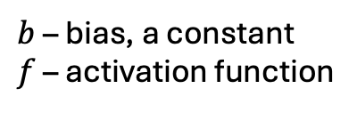
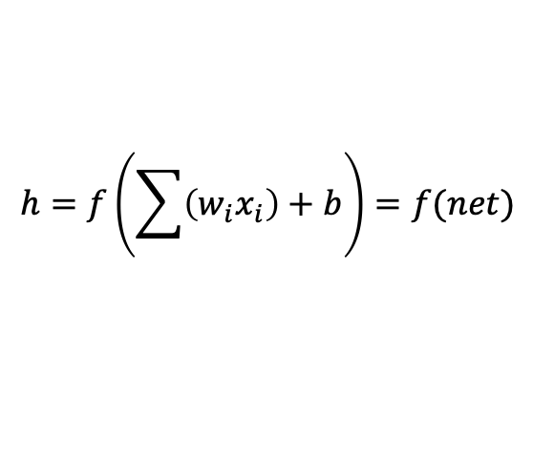
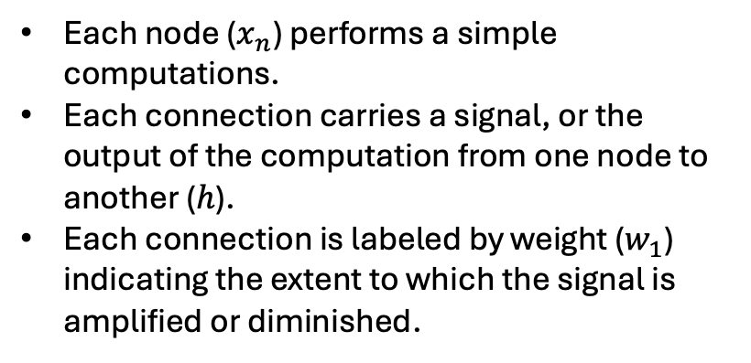
Neural Networks – repeat
Input
Each node ($x_{n}$) performs a simple computations.
Each connection carries a signal, or the output of the computation from one node to another ($h$).
Each connection is labeled by weight ($w_{1}$) indicating the extent to which the signal is amplified or diminished.
$$x_{1}$$
$$w_{1}$$
$$h_{1}$$
$$w_{2}$$
$$h_{5}$$
$$x_{2}$$
$$h_{2}$$
Output
$$h_{6}$$
$$\hat{y}$$
$$x_{3}$$
$$h_{3}$$
$$h_{7}$$
$$h_{4}$$
$$x_{4}$$
$$h=f\left(\sum{\left(w_{i}x_{i}\right)}+b\right)=f(net)$$
Hidden layers
A multi-layer feedforward neural network
$b$ – bias, a constant
$f$ – activation function

Slide 6
Convolutional Neural Network
A type of DL neural network architecutre
Used in Computer Vision – a field of AI that enables a computer to understand and interpret the image or visual data
CNN architectue = input layer, Convolutional layer, Pooling layer, and fully connected layers.
Convolutional layer
Max pooling layer
Dense layer
Input layer
Output layer
Image

Slide 7
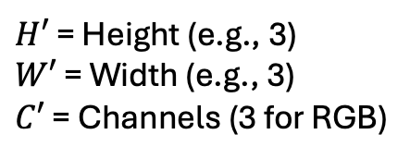
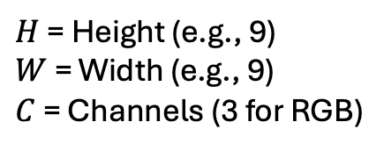
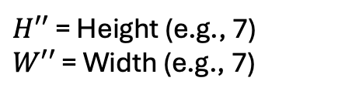
Convolution
Kernels
Feature maps
Input image
3 color chanels
Height
pixels
Width pixels
$H$ = Height (e.g., 9)
$W$ = Width (e.g., 9)
$C$ = Channels (3 for RGB)
$H′$ = Height (e.g., 3)
$W′$ = Width (e.g., 3)
$C′$ = Channels (3 for RGB)
$H′′$ = Height (e.g., 7)
$W′′$ = Width (e.g., 7)
(9 x 9 x 3)

Slide 8
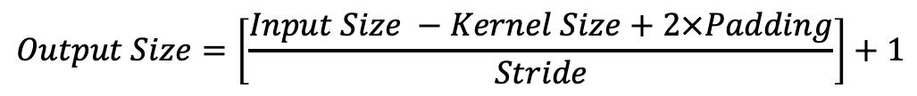
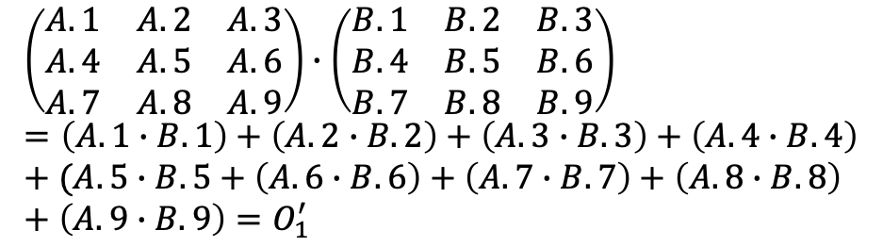
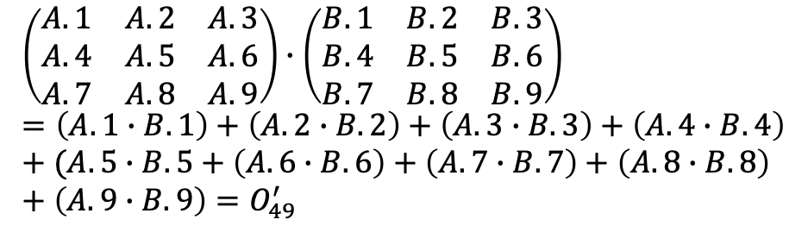
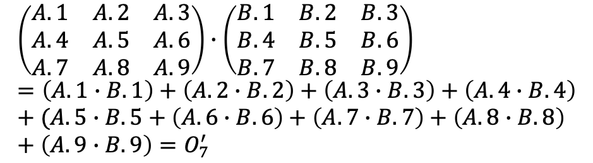
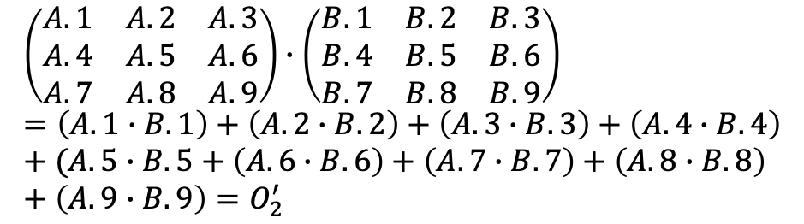
$$\left(\begin{matrix}A.1 & A.2 & A.3 \\ A.4 & A.5 & A.6 \\ A.7 & A.8 & A.9\end{matrix}\right)∙\left(\begin{matrix}B.1 & B.2 & B.3 \\ B.4 & B.5 & B.6 \\ B.7 & B.8 & B.9\end{matrix}\right)=\left(A.1∙B.1\right)+\left(A.2∙B.2\right)+\left(A.3∙B.3\right)+\left(A.4∙B.4\right)+(A.5∙B.5+\left(A.6∙B.6\right)+\left(A.7∙B.7\right)+\left(A.8∙B.8\right)+\left(A.9∙B.9\right)=O_{2}^{′}$$
 | 0
…
$$\left(\begin{matrix}A.1 & A.2 & A.3 \\ A.4 & A.5 & A.6 \\ A.7 & A.8 & A.9\end{matrix}\right)∙\left(\begin{matrix}B.1 & B.2 & B.3 \\ B.4 & B.5 & B.6 \\ B.7 & B.8 & B.9\end{matrix}\right)=\left(A.1∙B.1\right)+\left(A.2∙B.2\right)+\left(A.3∙B.3\right)+\left(A.4∙B.4\right)+(A.5∙B.5+\left(A.6∙B.6\right)+\left(A.7∙B.7\right)+\left(A.8∙B.8\right)+\left(A.9∙B.9\right)=O_{7}^{′}$$
…
$$\left(\begin{matrix}A.1 & A.2 & A.3 \\ A.4 & A.5 & A.6 \\ A.7 & A.8 & A.9\end{matrix}\right)∙\left(\begin{matrix}B.1 & B.2 & B.3 \\ B.4 & B.5 & B.6 \\ B.7 & B.8 & B.9\end{matrix}\right)=\left(A.1∙B.1\right)+\left(A.2∙B.2\right)+\left(A.3∙B.3\right)+\left(A.4∙B.4\right)+(A.5∙B.5+\left(A.6∙B.6\right)+\left(A.7∙B.7\right)+\left(A.8∙B.8\right)+\left(A.9∙B.9\right)=O_{49}^{′}$$
$$\left(\begin{matrix}A.1 & A.2 & A.3 \\ A.4 & A.5 & A.6 \\ A.7 & A.8 & A.9\end{matrix}\right)∙\left(\begin{matrix}B.1 & B.2 & B.3 \\ B.4 & B.5 & B.6 \\ B.7 & B.8 & B.9\end{matrix}\right)=\left(A.1∙B.1\right)+\left(A.2∙B.2\right)+\left(A.3∙B.3\right)+\left(A.4∙B.4\right)+(A.5∙B.5+\left(A.6∙B.6\right)+\left(A.7∙B.7\right)+\left(A.8∙B.8\right)+\left(A.9∙B.9\right)=O_{1}^{′}$$
$$Output Size=\left[\frac{Input Size −Kernel Size+2×Padding}{Stride}\right]+1$$

Slide 9
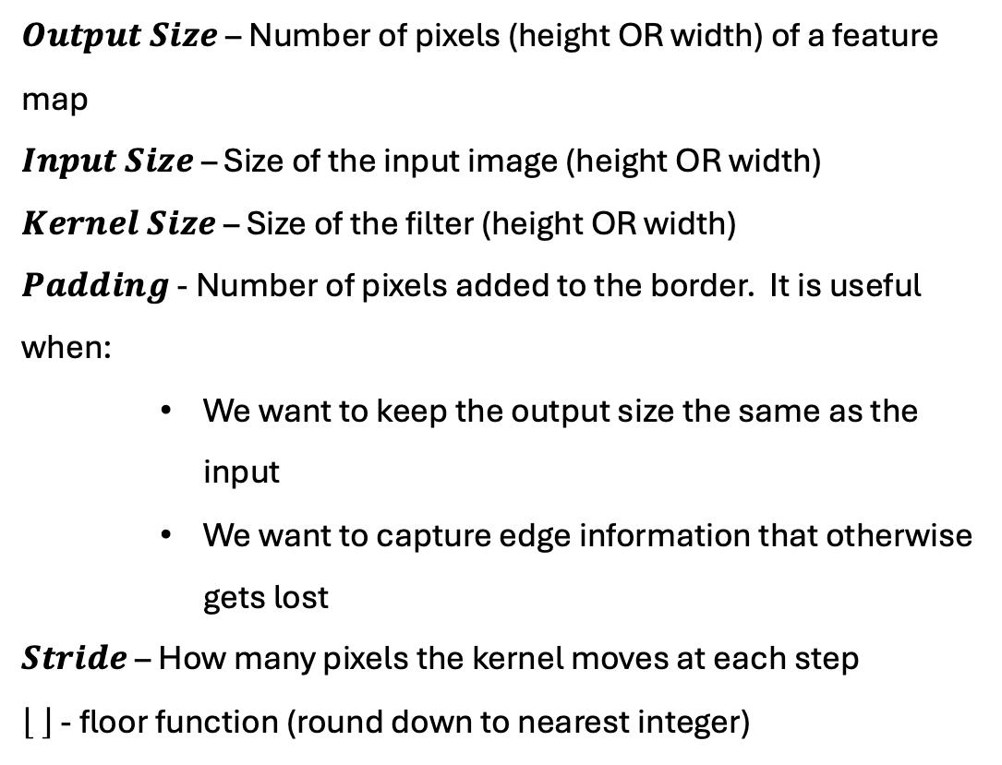
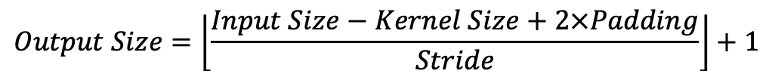
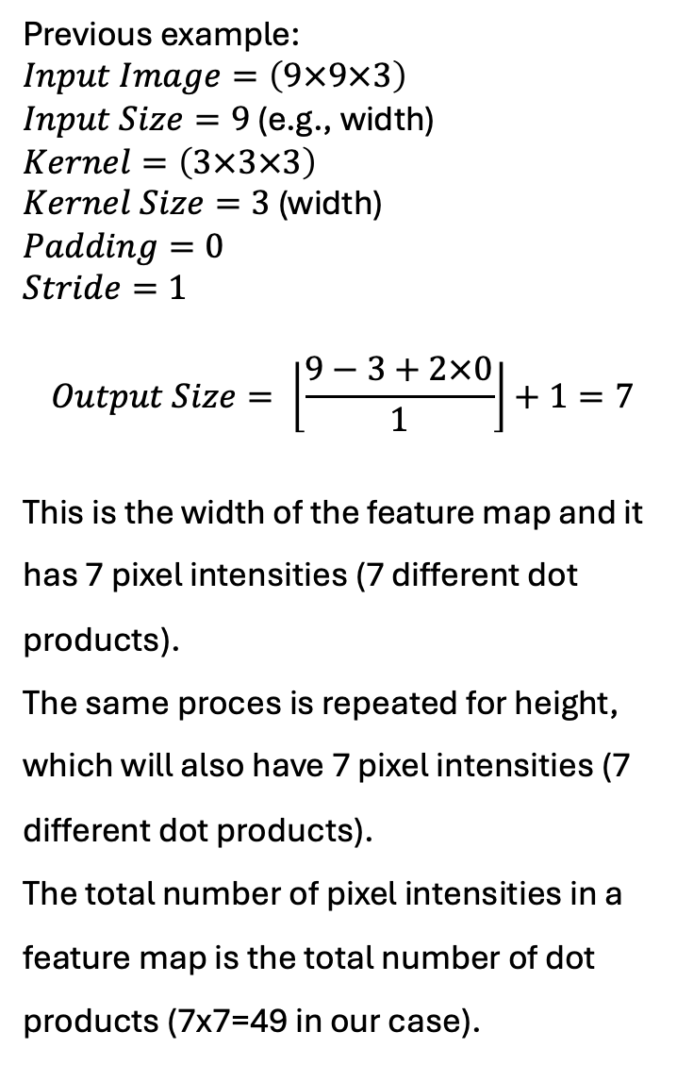
Previous example:
$Input Image=\left(9×9×3\right)$
$Input Size=9$ (e.g., width)
$Kernel=\left(3×3×3\right)$
$Kernel Size=3$ (width)
$Padding=0$
$Stride=1$
$$Output Size= \left\lfloor \frac{9−3+2×0}{1}\right\rfloor +1=7$$
This is the width of the feature map and it has 7 pixel intensities (7 different dot products).
The same proces is repeated for height, which will also have 7 pixel intensities (7 different dot products).
The total number of pixel intensities in a feature map is the total number of dot products (7x7=49 in our case).
$$Output Size=\left\lfloor \frac{Input Size−Kernel Size+2×Padding}{Stride}\right\rfloor +1$$
$Output Size$ – Number of pixels (height OR width) of a feature map
$Input Size$ – Size of the input image (height OR width)
$Kernel Size$ – Size of the filter (height OR width)
$Padding$ - Number of pixels added to the border. It is useful when:
We want to keep the output size the same as the input
We want to capture edge information that otherwise gets lost
$Stride$ – How many pixels the kernel moves at each step
- floor function (round down to nearest integer)

Slide 10
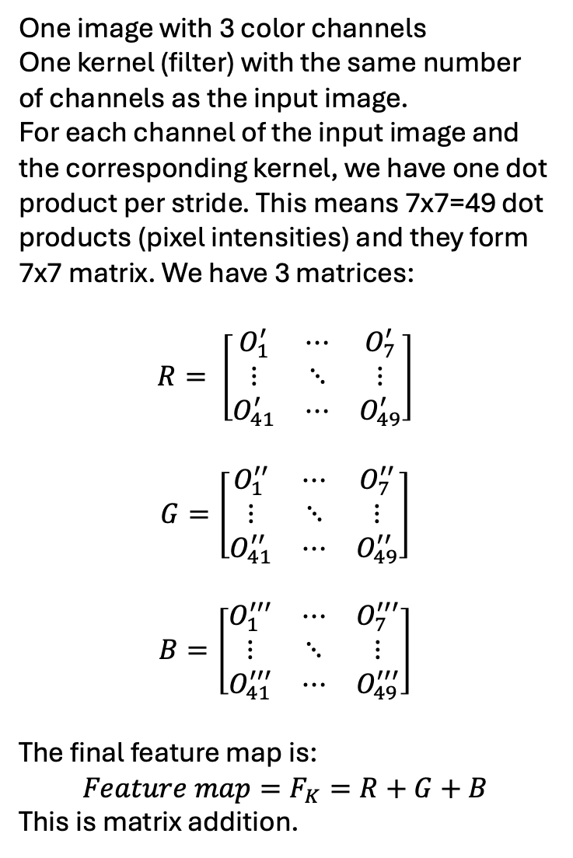
One image with 3 color channels
One kernel (filter) with the same number of channels as the input image.
For each channel of the input image and the corresponding kernel, we have one dot product per stride. This means 7x7=49 dot products (pixel intensities) and they form 7x7 matrix. We have 3 matrices:
$$R= \left[\begin{matrix}O_{1}^{′} & ⋯ & O_{7}^{′} \\ ⋮ & ⋱ & ⋮ \\ O_{41}^{′} & ⋯ & O_{49}^{′}\end{matrix}\right]$$
$$G=\left[\begin{matrix}O_{1}^{′′} & ⋯ & O_{7}^{′′} \\ ⋮ & ⋱ & ⋮ \\ O_{41}^{′′} & ⋯ & O_{49}^{′′}\end{matrix}\right]$$
$$B=\left[\begin{matrix}O_{1}^{′′′} & ⋯ & O_{7}^{′′′} \\ ⋮ & ⋱ & ⋮ \\ O_{41}^{′′′} & ⋯ & O_{49}^{′′′}\end{matrix}\right]$$
The final feature map is:
$$Feature map=F_{K}=R+G+B$$
This is matrix addition.
3 color chanels

Slide 11
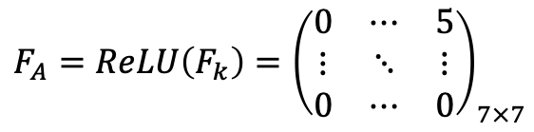
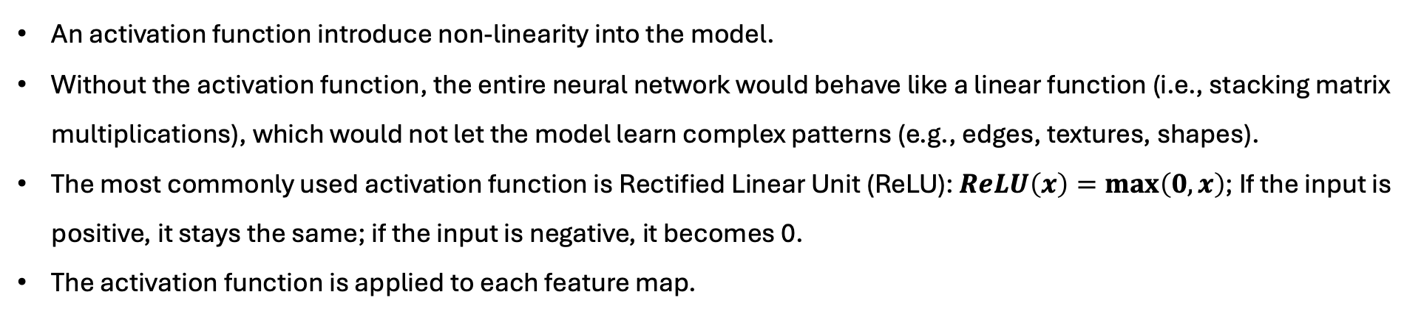
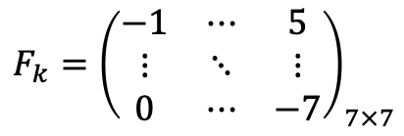
Applying Activation Function
An activation function introduce non-linearity into the model.
Without the activation function, the entire neural network would behave like a linear function (i.e., stacking matrix multiplications), which would not let the model learn complex patterns (e.g., edges, textures, shapes).
The most commonly used activation function is Rectified Linear Unit (ReLU): $ReLU\left(x\right)=\max\left(0,x\right)$; If the input is positive, it stays the same; if the input is negative, it becomes 0.
The activation function is applied to each feature map.
$$F_{k}={\left(\begin{matrix}−1 & ⋯ & 5 \\ ⋮ & ⋱ & ⋮ \\ 0 & ⋯ & −7\end{matrix}\right)}_{7×7}$$
$$F_{A}=ReLU\left(F_{k}\right)={\left(\begin{matrix}0 & ⋯ & 5 \\ ⋮ & ⋱ & ⋮ \\ 0 & ⋯ & 0\end{matrix}\right)}_{7×7}$$
Feature map
Activated feature map
The shape of the matrix stays the same after applying the activation function;
Negative values are converted to 0; This means ReLU removes negative noise (possibly irrelevant features are suppressed).
Positive values stay the same; ReLu function keeps important signls (strong positive activations are preserved).
Each feature map from the convolution layer is passed through ReLU.

Slide 12

Convolutional Neural Network
A type of DL neural network architecutre
Used in Computer Vision – a field of AI that enables a computer to understand and interpret the image or visual data
CNN architectue = input layer, Convolutional layer, Pooling layer, and fully connected layers.
Convolutional layer
Max pooling layer
Dense layer
Input layer
Output layer
Image

Slide 13
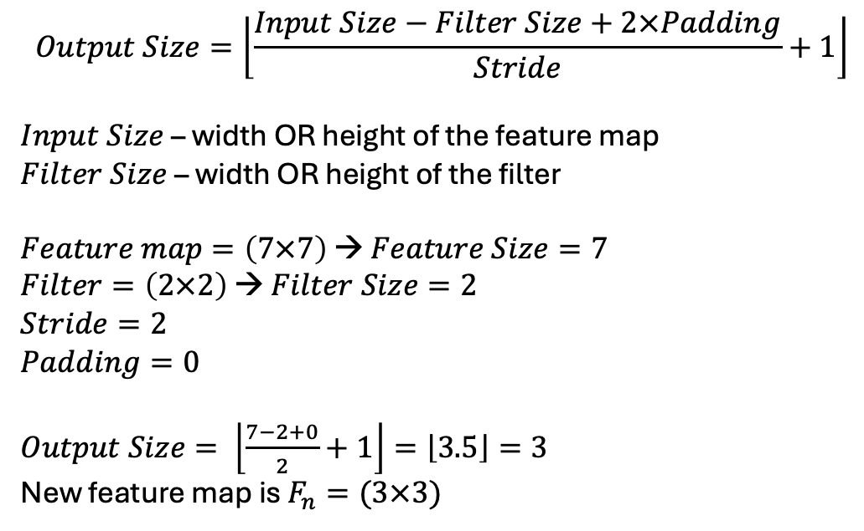
Pooling (Downsampling)
Pooling reduces the spatial dimensions (height and width) of the activated feature map.
This makes the model computationally efficient, reduces overfitting, and keep the most important features.
The most common type is Max Pooling, which takes the maximum value from a small region (patch) of the feature map. This keeps the strongest signal/feature from each region.
This is not a mathematical transformation like a convolution, but it is a purely selection-based operation in which we take the maximum value from the image (matrix patch).
$$Output Size=\left\lfloor \frac{Input Size−Filter Size+2×Padding}{Stride}+1\right\rfloor$$
$Input Size$– width OR height of the feature map
$Filter Size$ – width OR height of the filter
$Feature map=\left(7×7\right)$ → $Feature Size=7$
$Filter=\left(2×2\right)$ → $Filter Size=2$
$Stride=2$
$Padding=0$
$Output Size= \left\lfloor \frac{7−2+0}{2}+1\right\rfloor =\left\lfloor 3.5\right\rfloor =3$
New feature map is $F_{n}=(3×3)$
1 | 5
11 | 7
11

Slide 14
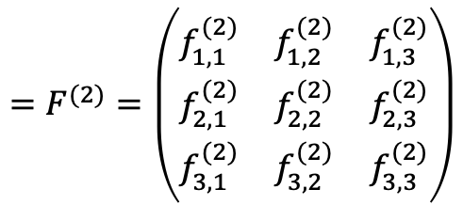
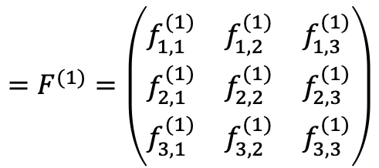
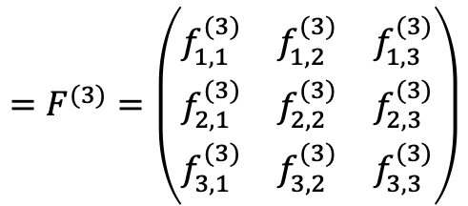
$$=F^{(1)}=\left(\begin{matrix}f_{1,1}^{(1)} & f_{1,2}^{(1)} & f_{1,3}^{(1)} \\ f_{2,1}^{(1)} & f_{2,2}^{(1)} & f_{2,3}^{(1)} \\ f_{3,1}^{(1)} & f_{3,2}^{(1)} & f_{3,3}^{(1)}\end{matrix}\right)$$
$$=F^{(2)}=\left(\begin{matrix}f_{1,1}^{(2)} & f_{1,2}^{(2)} & f_{1,3}^{(2)} \\ f_{2,1}^{(2)} & f_{2,2}^{(2)} & f_{2,3}^{(2)} \\ f_{3,1}^{(2)} & f_{3,2}^{(2)} & f_{3,3}^{(2)}\end{matrix}\right)$$
(9 x 9 x 3)
$$=F^{(3)}=\left(\begin{matrix}f_{1,1}^{(3)} & f_{1,2}^{(3)} & f_{1,3}^{(3)} \\ f_{2,1}^{(3)} & f_{2,2}^{(3)} & f_{2,3}^{(3)} \\ f_{3,1}^{(3)} & f_{3,2}^{(3)} & f_{3,3}^{(3)}\end{matrix}\right)$$
3 x (3 x 3 x 3)
3 x (7x7)
3 x (3x3)
Downsampling
Convolution + Activation

Slide 15
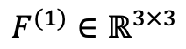
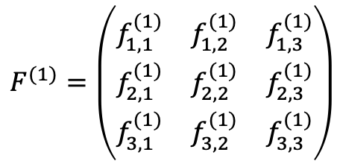
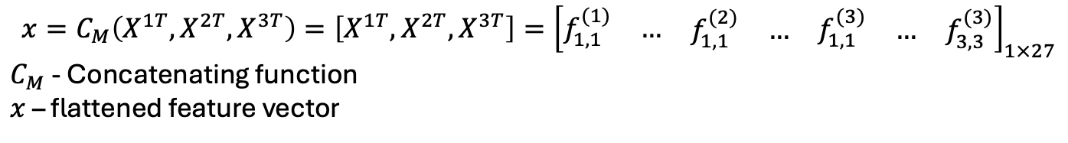
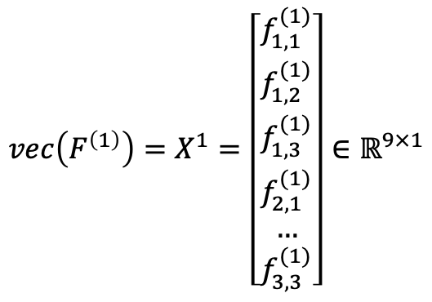
Flattening (Vectorization + Concatenation)
Fully connected (dense) layers expect a vector (1D input).
This layer converts a 3D layer in the network into a 1D vector
Since we had three 2D feature maps each 3x3 dimension, after flattening we will have 1D vector with 3x3x3=27 real numbers
Vectorization
$$vec\left(F^{\left(1\right)}\right)=X^{1}=\left[\begin{matrix}f_{1,1}^{(1)} \\ \begin{matrix}f_{1,2}^{(1)} \\ \begin{matrix}f_{1,3}^{(1)} \\ f_{2,1}^{(1)} \\ …\end{matrix}\end{matrix} \\ f_{3,3}^{(1)}\end{matrix}\right]∈ℝ^{9×1}$$
$$F^{(1)}=\left(\begin{matrix}f_{1,1}^{(1)} & f_{1,2}^{(1)} & f_{1,3}^{(1)} \\ f_{2,1}^{(1)} & f_{2,2}^{(1)} & f_{2,3}^{(1)} \\ f_{3,1}^{(1)} & f_{3,2}^{(1)} & f_{3,3}^{(1)}\end{matrix}\right)$$
$$X^{1T}=\left[\begin{matrix}f_{1,1}^{(1)} & \begin{matrix}f_{1,2}^{(1)} & f_{1,3}^{(1)} & \begin{matrix}f_{2,1}^{(1)} & …\end{matrix}\end{matrix} & f_{3,3}^{(1)}\end{matrix}\right]∈ℝ^{1×9}$$
1D vector
$$F^{(1)}∈ℝ^{3×3}$$
$${x=C}_{M}\left(X^{1T},X^{2T},X^{3T}\right)=\left[X^{1T},X^{2T},X^{3T}\right]={\left[\begin{matrix}f_{1,1}^{(1)} & … & \begin{matrix}\begin{matrix}f_{1,1}^{(2)} & …\end{matrix} & f_{1,1}^{(3)} & \begin{matrix}… & f_{3,3}^{(3)}\end{matrix}\end{matrix}\end{matrix}\right]}_{1×27}$$
$C_{M}$ - Concatenating function
$x$ – flattened feature vector

Slide 16
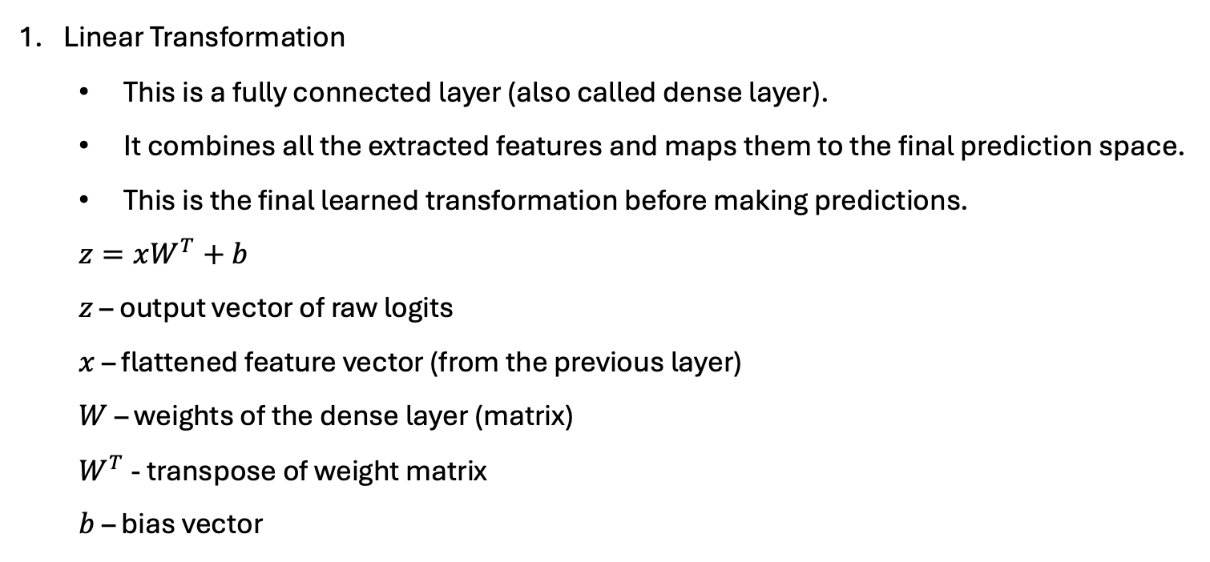
Fully Connected (Dense) Layer
Linear Transformation
This is a fully connected layer (also called dense layer).
It combines all the extracted features and maps them to the final prediction space.
This is the final learned transformation before making predictions.
$z=xW^{T}+b$
$z$ – output vector of raw logits
$x$ – flattened feature vector (from the previous layer)
$W$ – weights of the dense layer (matrix)
$W^{T}$ - transpose of weight matrix
$b$ – bias vector
A weight matrix in a neural network is a matrix of trainable parameters that determine the strength of the connections between neurons.
Each weight controls how much influence a specific input has on the output.
A bias vector is a trainable vector added to the output of a neuron after the weighted sum, allowing the model to better fit the data by shifting the activation function.
Both weights and biases are updated during backpropagation using gradient descent to minimize the loss.

Slide 17
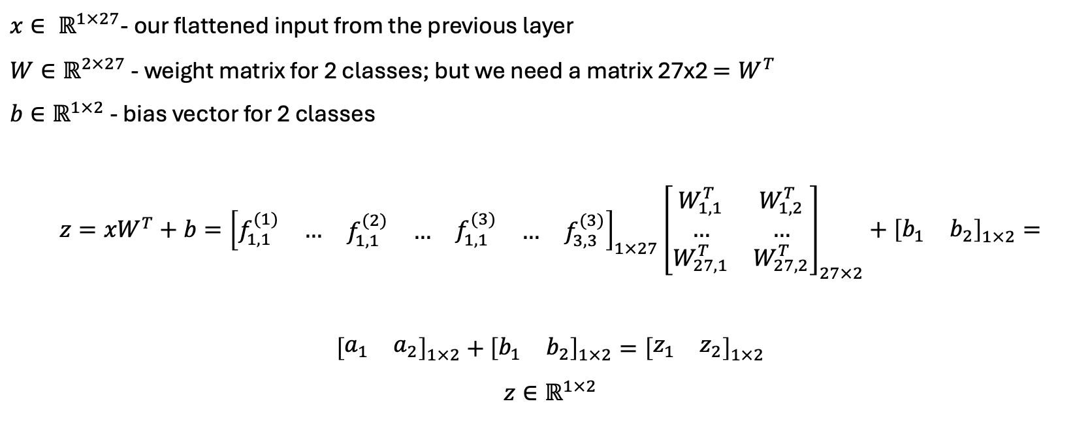
If we have 2 classes = meaning the model is trying to classify inputs into one of 2 possible categories (e.g., 2 types of objects), each class has a corresponding output neuron – so the final layer will output 2 values.
$x∈ ℝ^{1×27}$- our flattened input from the previous layer
$W∈ℝ^{2×27}$ - weight matrix for 2 classes; but we need a matrix 27x2 $=W^{T}$
$b∈ℝ^{1×2}$ - bias vector for 2 classes
$$z={xW}^{T}+b={\left[\begin{matrix}f_{1,1}^{(1)} & … & \begin{matrix}\begin{matrix}f_{1,1}^{(2)} & …\end{matrix} & f_{1,1}^{(3)} & \begin{matrix}… & f_{3,3}^{(3)}\end{matrix}\end{matrix}\end{matrix}\right]}_{1×27}{\left[\begin{matrix}W_{1,1}^{T} & W_{1,2}^{T} \\ … & … \\ W_{27,1}^{T} & W_{27,2}^{T}\end{matrix}\right]}_{27×2}+{\left[\begin{matrix}b_{1} & b_{2}\end{matrix}\right]}_{1×2}=$$
${\left[\begin{matrix}a_{1} & a_{2}\end{matrix}\right]}_{1×2}+$ ${\left[\begin{matrix}b_{1} & b_{2}\end{matrix}\right]}_{1×2}={\left[\begin{matrix}z_{1} & z_{2}\end{matrix}\right]}_{1×2}$
$$z∈ℝ^{1×2}$$
For $i$ classes we will have $i$ values (logits) as an output; the logits are the elements of a 1D vector $z$

Slide 18
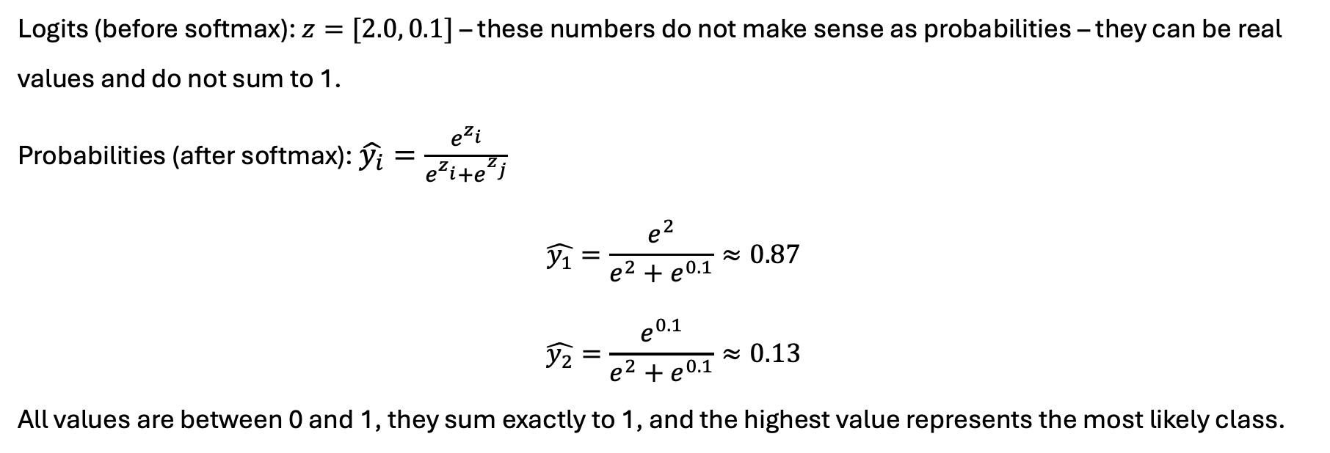
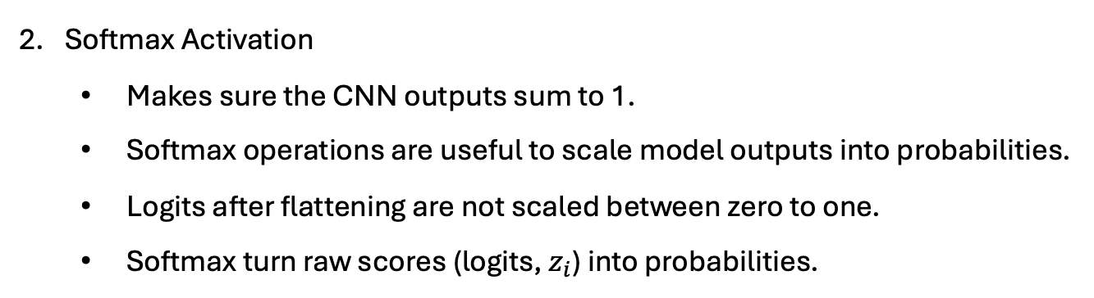
Fully Connected (Dense) Layer
Softmax Activation
Makes sure the CNN outputs sum to 1.
Softmax operations are useful to scale model outputs into probabilities.
Logits after flattening are not scaled between zero to one.
Softmax turn raw scores (logits, $z_{i}$) into probabilities.
Logits (before softmax): $z=[2.0, 0.1]$ – these numbers do not make sense as probabilities – they can be real values and do not sum to 1.
Probabilities (after softmax): $\hat{y_{i}}=\frac{e^{z_{i}^{ }}}{e^{z_{i}^{ }}+e^{z_{j}^{ }}}$
$$\hat{y_{1}}=\frac{e^{2}}{e^{2}+e^{0.1}}≈0.87$$
$$\hat{y_{2}}=\frac{e^{0.1}}{e^{2}+e^{0.1}}≈0.13$$
All values are between 0 and 1, they sum exactly to 1, and the highest value represents the most likely class.
The model is 87% confident in class 1

Slide 19
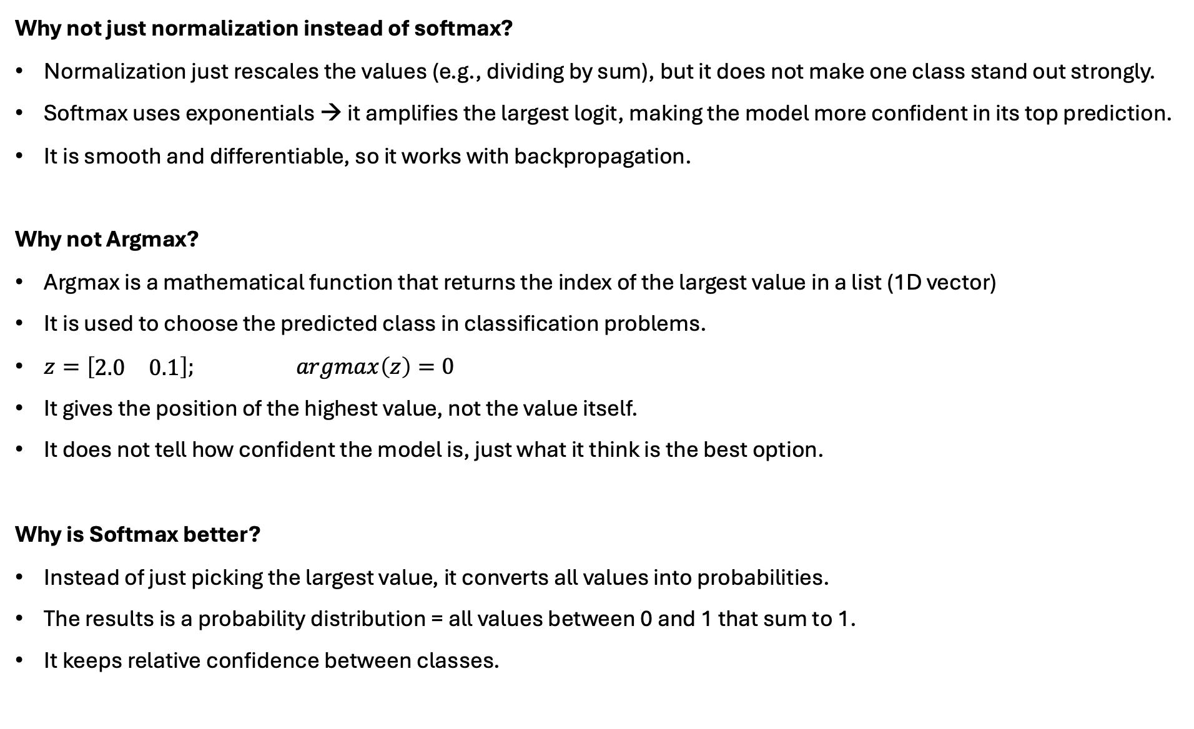
Why not just normalization instead of softmax?
Normalization just rescales the values (e.g., dividing by sum), but it does not make one class stand out strongly.
Softmax uses exponentials → it amplifies the largest logit, making the model more confident in its top prediction.
It is smooth and differentiable, so it works with backpropagation.
Why not Argmax?
Argmax is a mathematical function that returns the index of the largest value in a list (1D vector)
It is used to choose the predicted class in classification problems.
$z=\left[\begin{matrix}2.0 & 0.1\end{matrix}\right];$ $argmax\left(z\right)=0$
It gives the position of the highest value, not the value itself.
It does not tell how confident the model is, just what it think is the best option.
Why is Softmax better?
Instead of just picking the largest value, it converts all values into probabilities.
The results is a probability distribution = all values between 0 and 1 that sum to 1.
It keeps relative confidence between classes.

Slide 20
What happens after Softmax?
Once softmax gives us the predicted probabilities, we have:
Loss Computation – calculation of the loss (error) using a suitable loss function like Cross-Entropy.
Gradient Calculation – use of gradient descent to compute how much each weight and bias contributed to the error – this gives us the gradients.
Backpropagation – propagate the error backward through the network to update all the weights and biases (including convolutional kernels).
This cycle repeats for many epochs to improve the model.

Slide 21
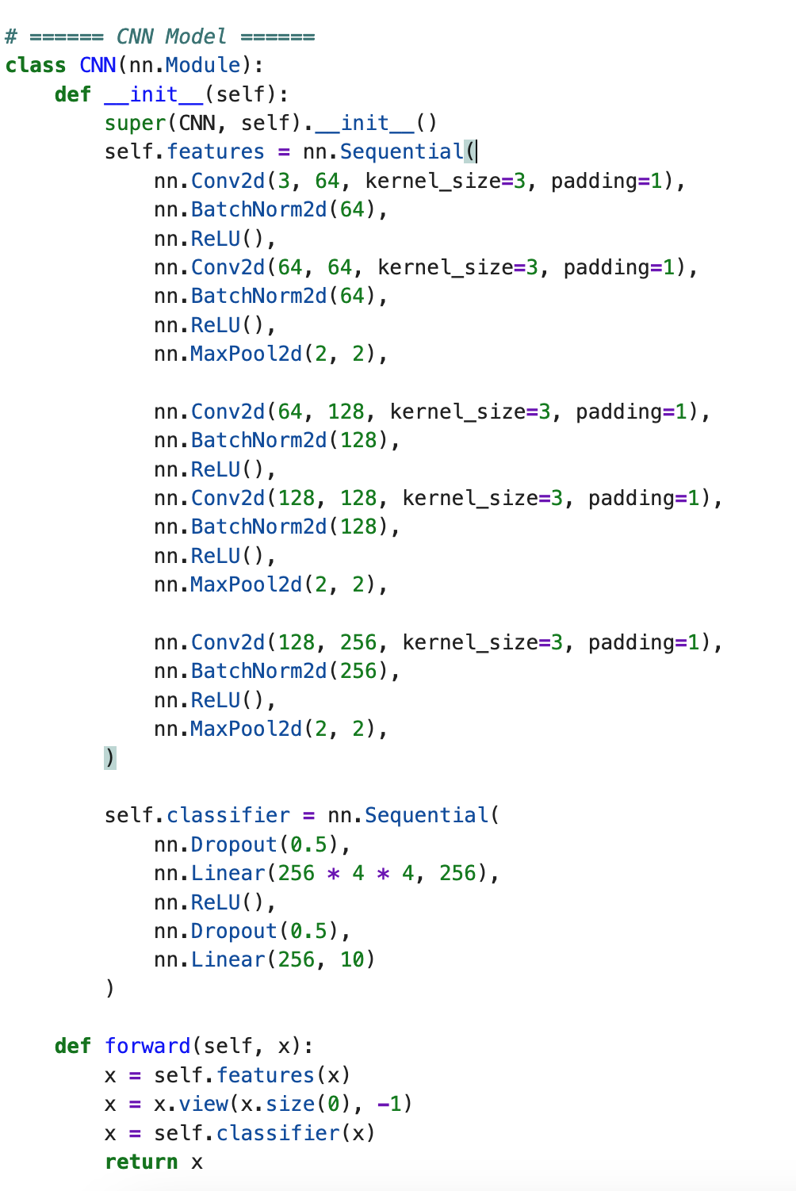
Conv2d = convolution
BatchNorm2d = normalization of feature maps
ReLU = activation function
MaxPool2d = downsampling (pooling)
Conv2d(number_of_input_channels, number_of_kernels_applied, kernel_size, padding)
BatchNorm2d(number_of_output_feature_maps)
MaxPool2d(reduce_height_by_number, reduce_width_by_number)
Classifier – the fully connected (dense) part of the CNN model
Runs the CNN layers: conv, relu, pool,…
Flatten the output
Runs the fully connected classifier

Slide 22
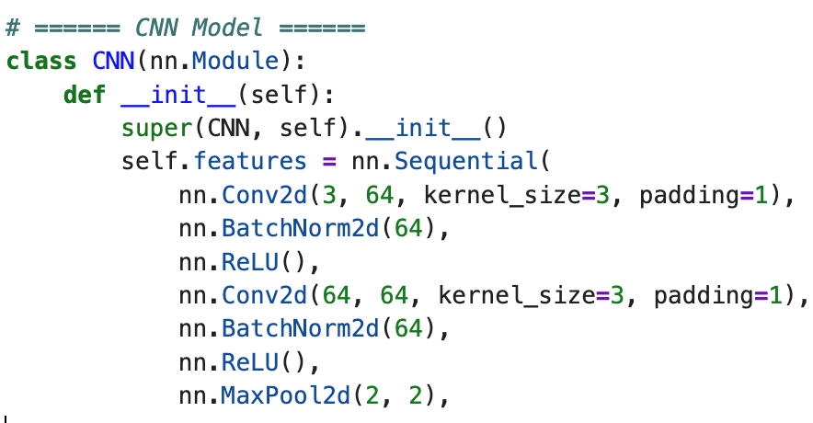
Your turn:
Explain what we have in this code:
Is this grayscale or color image? Why?
What is the kernel size?
How many kernels we apply in both convolutions
How many feature maps we have after first convolution?
If the input image has height=32 pixels and width=32 pixels, what is the output size after first and after second convolution?
What is the size of the output after MaxPooling?

Slide 23
Answers:
Explain what we have in this code:
Is the input grayscale or color image? Why? – it is color image, since it has 3 channels (RGB).
What is the kernel size? – 3x3x3
How many kernels we apply in both convolutions? – 64 per convolution
How many feature maps we have after first convolution? – 64 (the same number as kernels).
If the input image has height=32 pixels and width=32 pixels, what is the output size after first and after second convolution? – Since padding =1, the output size is the same as the input 32x32.
What is the size of the output after MaxPooling? - this MaxPooling reduces both height and width by 2; the output is 16x16

Slide 24
Why Deep Learning needs HPC?
Deep Learning Models (DNN & CNN) require extensive computation to process massive datasets.
Training models on regular computer is often slow, inefficient, or simply not possible.
For massive datasets, with milions of parameters, for complex models with many layers, High-Performance Computing (HPC) becomes essential.
HPC has large clusters of CPUs and GPUs which accelerate model training, enable parallel computation, and reduce the time required to tune and deploy deep learning models.
CPU (Central Processing Unit) - a general purpose processor having cores optimized for sequential and branch-heavy operations.
CPUs are suitable for orchestrating model training, pre-processing data, and handling I/O.
GPU (Graphic Processing Unit) – a processor originally designed for rendering graphics, but now widely used in parallel numerical computations.
A GPU consists of many smaller, simpler cores capable of executing operations simultaneously.
GPUs accelerate the training phase by parallelizing the heavy computations involved in backpropagation.
HPC provides the necessary compute power, memory, and throughput.

Slide 25
High Performance Computing
Sequential (serial) computing
All operations are performed sequentially using single core processor;
Can exectute 1 instruction at a time
All layers and computations happen in sequence
It is slower, especially with large datasets or complex models.
Simple but not efficient!
Parallel computing
The task is split into smaller subtasks processed simultaneously across multiple cores or processors within a single node (machine)
One machine, many cores
Distributed parallel computing
The computations are split across multiple machines (nodes)
These nodes communicate over a network to work on the same task.
Many machines, each with their own cores, working together

Slide 26
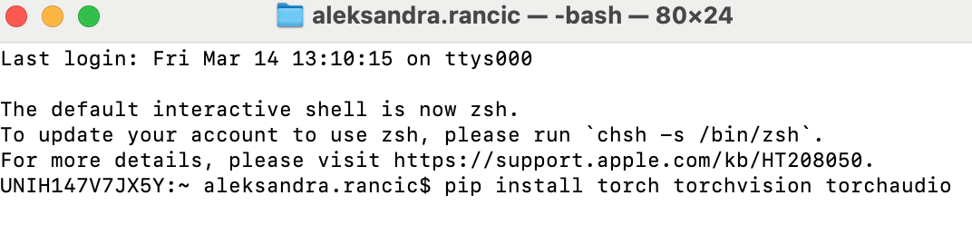
PyTorch
PyTorch is an open-source ML framework developed by Meta AI
Widely used for building and training deep learning models
Supports tensors operations, automatic differentiation, and GPU acceleration
It is easy to integrate within the Python code
PyTorch Modules we will use:
Torch: Tensors, models, losses, optimizers
Torch.nn: neural network layers
Torch.optim: optimizers like Adam, SGD
Torchvision: datasets and image transforms
PyTorch is used for:
Building neural networks (CNNs, RNNs, Transformers, GANs, etc.)
Training DL models on large datasets
Reseacrh and prototyping (easy debugging and flexible)
Production (using TorchScript, ONNX, TensorRT, etc.)

Slide 27
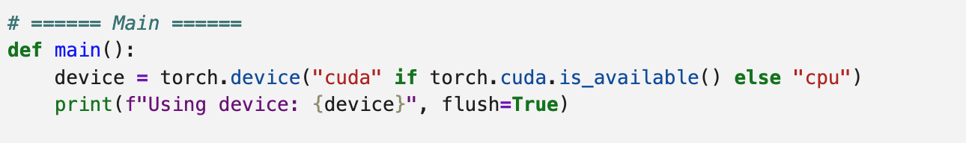
PyTorch
When using PyTorch, we need to specify where to run tensors and models: on the CPU or the GPU.
PyTorch does not autmoatically move tensors or models to GPU.
We must explicitly define the device and move both the model and data to it.
Use “cpu” to run on CPU
Use “cuda” to run on GPU
Data and model must be on the same device to avoid runtime errors.
Use .to(device) to move tensors or models

Slide 28
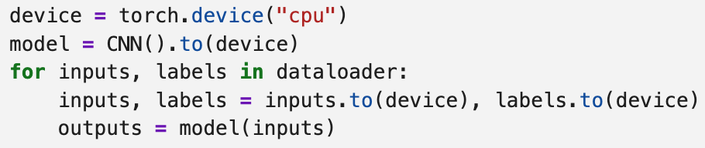
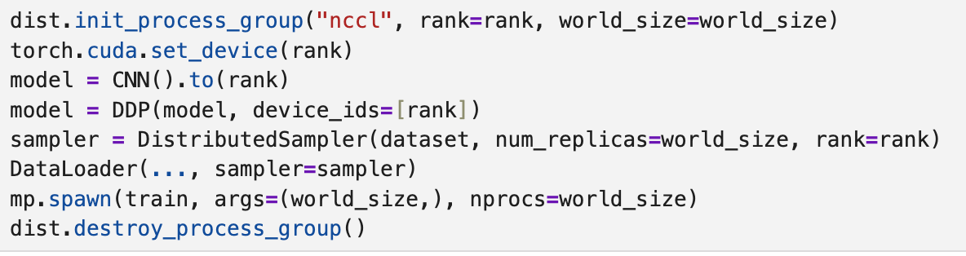
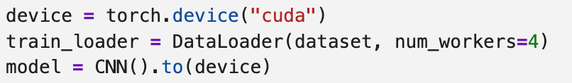
PyTorch
Sequential training (single CPU or GPU)
Distributed Data Parallel
Initialize the process group
Wrap model with DDP
Use distributed sampler for data
Spawn process
Cleanup
Parallel programming – (single node, multi-core CPU or GPU)

Slide 29
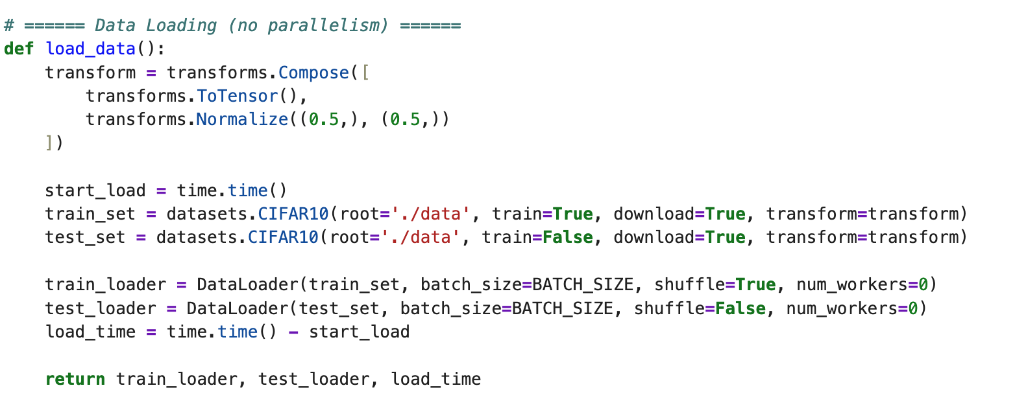
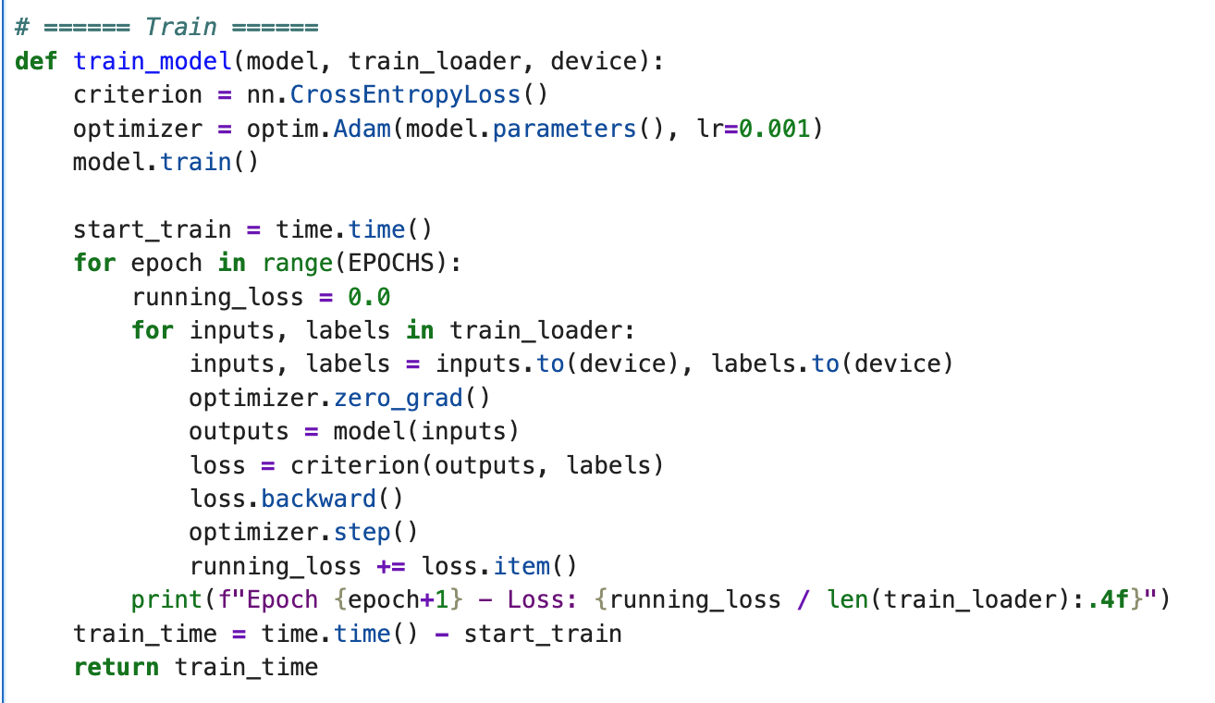
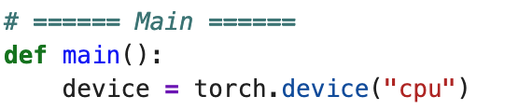
Running the CNN model on CPU without parallelism
Loads one batch at a time
Each batch of inputs and labels is moved to the CPU
Clears the gradient before computing them (sequential operation)
Each input is processed in order
CNN model
Clearly shows the model is explicitly set to run on CPU

Slide 30
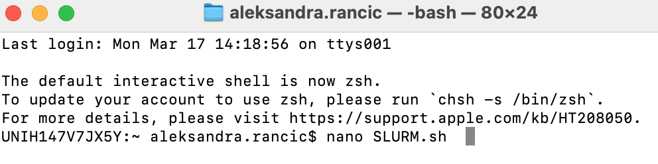
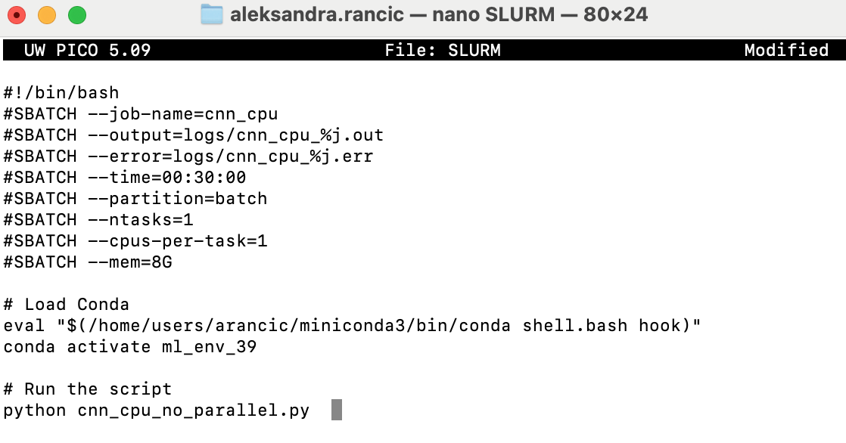
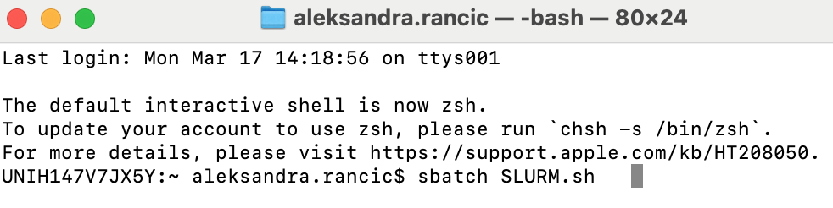
Running the CNN model on CPU without parallelism
Ctrl+o = to save script Enter
Ctrl+X = to exit
Your turn:
Write the BATCH script and run it on HPC
-Set a meaningful job name
-Specify the time limit
-Request 1 task and n CPUs per task (what is n for sequential?)
-Request enough of memory
-Activate the environment properly
- Run your Python script

Slide 31
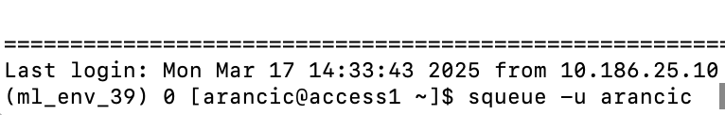
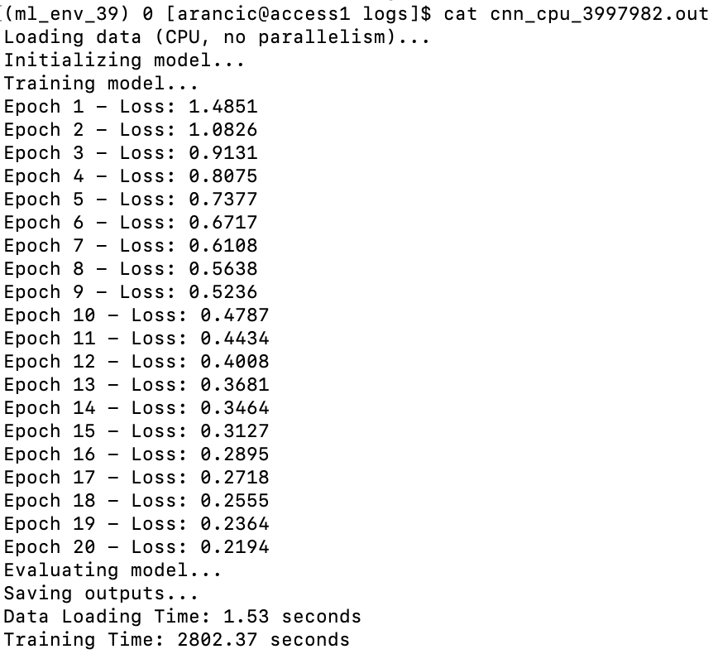
To check the status of your job:
To check the errors:
To follow the errors while the code is running:
To follow the outputs while the code is running:
To check the output:

Slide 32

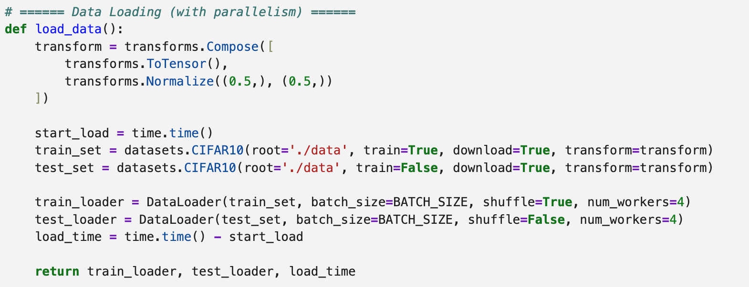
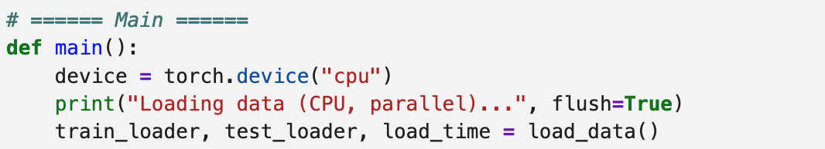
Running the CNN model on CPU with parallelism
Shows that model training is allowed to use 4 CPU threads (parallel CPU execution)
num_workers = 4 tells PyTorch to use 4 subprocesses for loading the data – this parallelized the data loading.
Device configuration clearly showing the usage of CPU

Slide 33
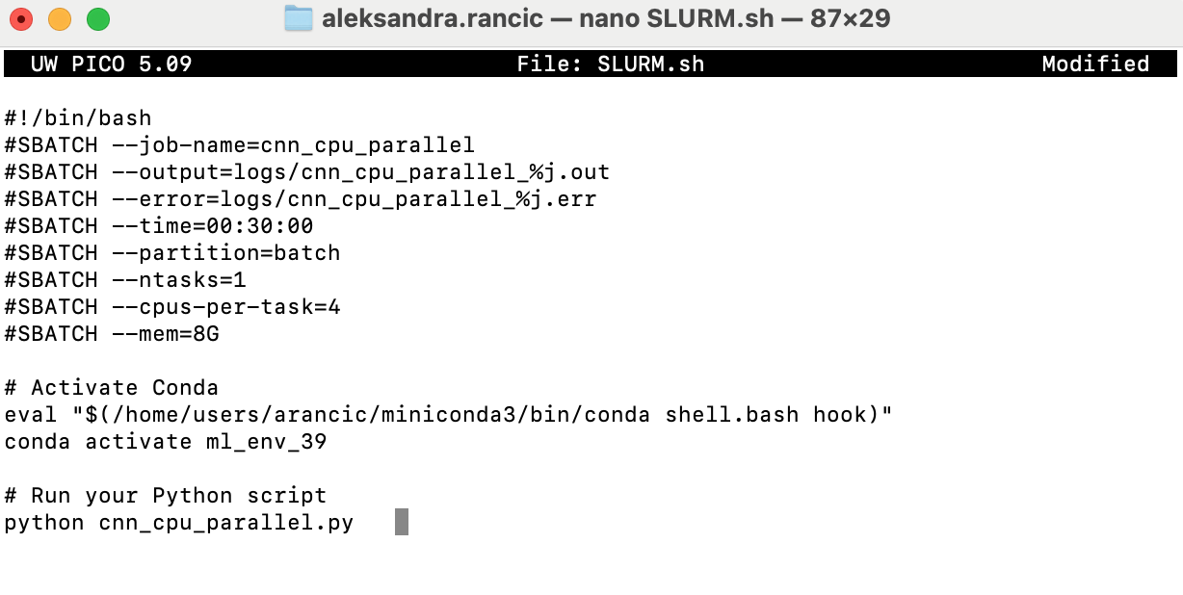
Running the CNN model on CPU with parallelism
Your turn:
Write the BATCH script and run it on HPC
-Set a meaningful job name
-Specify the time limit
-Request n tasks and n CPUs per task (what is n in our Python script?)
-Request enough of memory
-Load modules
- Run your Python script

Slide 34
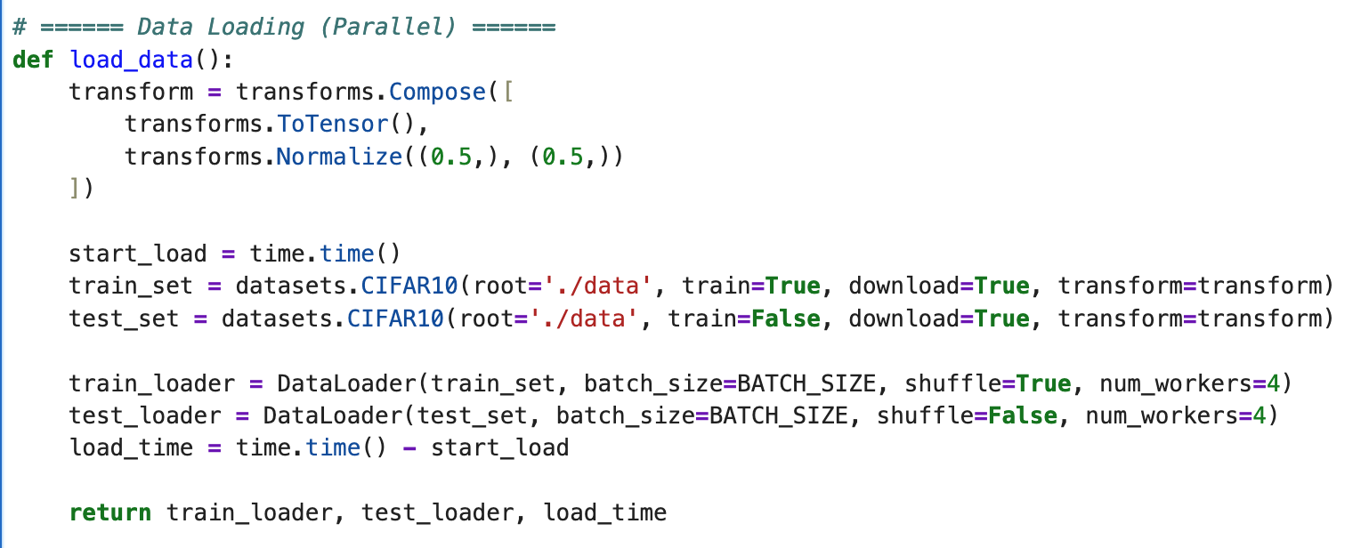


Running the CNN model on GPU
Data loading happens on the CPU because preprocessing and I/O (loading, decoding, augmentation) are CPU-bound tasks. You do not want to block GPU waiting for data
This ensures the model will run on the GPU if available
Before running the model on GPU, the data must be sent to GPU

Slide 35

Running the CNN model on GPU
Your turn:
Write the BATCH script and run it on HPC
-Set a meaningful job name
-Specify the time limit
-Request 1 GPU
-Request n task and n CPUs per task (what is n in our Python script?)
-Activate the environment properly
Run your Python script
Is this parallel programming?

Slide 36


Running the CNN model with Distributed Data Parallel
Initializes communication between processes and assigns each process to a specific GPU
Each process is assigned a rank and a GPU, and they all communicate using NCCL backend.
The dataset is split among all processes. Each process uses 4 CPU workers to load its own partition in parallel.
This is distributed data parallelism – both CPUs and GPUs across multiple nodes are working together.
The model is wrapped with DistributedDataParallel to synchronize graidents across GPUs on different nodes

Slide 37

Running the CNN model with Distributed Data Parallel
Your turn:
Write the BATCH script and run it on HPC
-Set a meaningful job name
-Specify the time limit
-Request n GPU
-Request n task and n CPUs per task (what is n in out Python script?)
-Activate the environment properly
Run your Python script

Slide 38
Communication vs. Computation
When you train on multiple GPUs across multiple nodes (DDP), your model can calculate faster because more GPUs share the work – BUT it also needs to communicate more between nodes, which adds time.
That communication cost (especially over a network) can be bigger than the gain from extra GPUs if the dataset is small.
On the other hand, using multiple GPUs on a single node means:
Computation is still fast, and
Communication is much cheaper.
For small or medium datasets, it is better to use multiple GPUs on one node – fast, simple, low overhead.
For large datasets or huge models, you will need more memory and power, so DDP across nodes becomes necessary – even if communication is more expensive.

Slide 39

Other Frameworks Used for ML & DL on HPC
DASK:
Open-source Python library for parallel computing
It scales Python code form multi-core local machines to large distributed clusters
Designed to work with Python tools like NumPy, pandas, and scikit-learn
Enables parallel and distributed computing
It was built to overcome the storage limitations of a single machine and extend the computation capabilities of NumPy, pandas, and scikit-learn with DASK equivalents
It is perfect for data that does not fit in RAM
Once familiar with Pandas, Dask feels very intuitive

Slide 40

Other Frameworks Used for ML & DL on HPC
DASK-ML:
Open-source Python library for scalable ML with Dask
Extends scikit-learn-style APIs to parallel and distributed settings
Designed to scale ML workflows from laptops to large HPC clusters
Integrates with Dask DataFrames and Dask Arrays
Supports preprocessing, model selection
Familiar interface for scikit-learn users, but built for big data

Slide 41
Other Frameworks Used for ML & DL on HPC
cuDF:
GPU DataFrame library (similar to pandas) from RAPIDS.ai
Provides pandas-like syntax but operates on NVIDIA GPUs
Ideal for large datasets that benefit from GPU acceleration
Allows fast, memory-efficient data manipulation on the GPU
Integrates easily with other RAPIDS libraries (e.g., cuML, cuGraph)
cuML:
GPU-accelerated ML library
Offers high-speed implementations of ML algoritms
Designed for multi-GPU and distributed setups (via Dask)
Shares familiar APIs from scikit-learn
Scales from laptops with CUDA GPUs to HPC clusters
Both cuDF & cuML are NVIDIA’s libraries, part of the RAPIDS AI suite for GPU-accelerated data science.
They are designed for CUDA (Compute Unified Device Architecture) - NVIDIA’s platform for programming GPUs to perform parallel computing.

Slide 42


Using pandas + scikit-learn (CPU)
Using cuDF + cuML (GPU)

Slide 43

Other Frameworks Used for ML & DL on HPC
Horovod:
An open-source DL framework for distributed parallel programming
Designed for training DL models scross multiple GPUs and multiple nodes
Supports frameworks such as TensorFlow, PyTorch, Keras
It leverages NCCL (NVIDIA Collective Communications Library) or MPI (Message Passing Interface) for high-performance communication between GPUs.
Accelerates trainings in large-scale environments
Simplifies the process of writing distributed training code
Horovod is “easier” when:
We want a simple setup across many GPUs/nodes
We are working with both TensorFlow and PyTorch
We want automatic optimizer scaling and synchronization
It works with SLURM:

Slide 44
Other Frameworks Used for ML & DL on HPC
TensorRT:
A high-performance DL inference framework developed by NVIDIA
It is a Software Development Kit (SDK) – a collection of tools, libraries, and documentation that helps developers build software for specific platform or framework
Can be used with Python – allows to integrate model optimization and inference into Python-based DL workflows
TensorRT is useful for DL and HPC because:
Speeds up inference by optimizing trained models for GPU execution
Uses precision calibration to reduce computation while keeping accuracy
Reduces memory usage
Works well with large-scale DL models in real-time
Support deployment on NVIDIA GPUs, making it ideal for HPC clusters with CUDA support
DL models run faster and use less memory
TensorRT itself does not require a specific SLURM configuration. It is a library used within a code to optimize and run deep learning models efficiently.

